Slide 1
Chapter 2: Intermediate JDBC

Slide 2
Learning Objectives
Intermediate JDBC:
Exception Handling and Cleanup
Working with Stored Procedures
Working with Database Functions
Connection Interface
Connecting with DriverManager
Executing PreparedStatement
Executing CallableStatement
Batch Operations with JDBC

Slide 3
Servlet – Key Methods
init() method:
When a servlet instance is created, its init() method is invoked. The init() method allows a servlet to initialize itself before the first request is processed.
service() method:
The web container calls the service method each time when request for the servlet is received. If servlet is not initialized, it follows the first three steps as described above then calls the service method. If servlet is initialized, it calls the service method. Notice that servlet is initialized only once.
destroy() method:
When a servlet is unloaded by the servlet container, its destroy() method is called. This step is only executed once, since a servlet is only unloaded once.
A servlet is unloaded by the container if the container shuts down, or if the container reloads the whole web application at runtime.

Slide 4
Accessing Parameters
Use HttpServletRequest.getParameterNames to get an Enumeration of parameter names.
Use HttpServletRequest.getParameterValues(paramName) to get the parameters values.
In a GET request, the request parameters are taken from the query string (the data following the question mark on the URL). For example, the URL http://hostname.com?p1=v1&p2=v2 contains two request parameters – – p1 and p2. In a POST request, the request parameters are taken from both query string and the posted data which is encoded in the body of the request.
The Student registration page demonstrates how to read parameters from a POST request.

Slide 5
HTTP headers and MIME types…
When a browser requests for a web page, it sends lot of information to the web server which cannot be read directly because this information travel as a part of header of HTTP request.
Here are the most common headers:
Accept The MIME types the browser prefers.
Accept-Charset The character set the browser expects.
Accept-Encoding The types of data encodings (such as gzip) the browser knows how to decode. Servlets can explicitly check for gzip support and return gzipped HTML pages to browsers that support them, setting the Content-Encoding response header to indicate that they are gzipped. In many cases, this can reduce page download times by a factor of five or ten.
Accept-Language The language the browser is expecting, in case the server has versions in more than one language.
Authorization Authorization info, usually in response to a WWW-Authenticate header from the server.

Slide 6
HTTP headers and MIME types…
More http headers:
Connection: If a servlet gets a Keep-Alive value here, or gets a request line indicating HTTP 1.1 (persistent connections), it may be able to take advantage of persistent connections. To do this, it needs to send a Content-Length header in the response, which is most easily accomplished by writing into a ByteArrayOutputStream, then looking up the size just before writing it out.
Content-Length (for POST messages, how much data is attached)
Cookie (one of the most important headers; see separate section in this tutorial on handling cookies)
From (email address of requester; only used by Web spiders and other custom clients, not by browsers)
Host (host and port as listed in the original URL)
If-Modified-Since (only return documents newer than this, otherwise send a 304 "Not Modified" response)
Pragma (the no-cache value indicates that the server should return a fresh document, even if it is a proxy with a local copy)
Referer (the URL of the page containing the link the user followed to get to current page)
User-Agent (type of browser, useful if servlet is returning browser-specific content)

Slide 7
ServletConfig interface
Servlet Container creates ServletConfig object for each Servlet during initialization, to pass information to the Servlet. This object can be used to get configuration information such as parameter name and values from deployment descriptor file(web.xml).
Methods of ServletConfig interface:
Method | Description
public String getInitParameter(String name): | Returns the value of given parameter as String, or null if the given parameter doesn’t exist in web.xml.
public Enumeration getInitParameterNames(): | Returns an enumeration of all the parameter names.
public String getServletName(): | Returns the name of the servlet instance.
public ServletContext getServletContext(): | Returns an object of ServletContext.

Slide 8
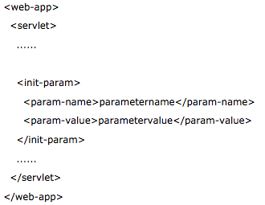
Using ServletConfig
How to get the object of ServletConfig?
getServletConfig() method of Servlet interface returns the object of ServletConfig.
Syntax to provide the initialization parameter for a servlet:

Slide 9
ServletContext interface
An object of ServletContext is created by the web container at time of deploying the project. This object can be used to get configuration information from web.xml file.
There is only one ServletContext object per web application.If any information is shared to many servlet, it is better to provide it from the web.xml file using the <context-param> element.
Method | Description
public String getInitParameter(String name): | Returns the parameter value for the specified parameter name.
public Enumeration getInitParameterNames(): | Returns the names of the context's initialization parameters.
public void setAttribute(String name,Object object): | sets the given object in the application scope.
public Object getAttribute(String name): | Returns the attribute for the specified name.
public Enumeration getInitParameterNames(): | Returns the names of the context's initialization parameters as an Enumeration of String objects.
public void removeAttribute(String name): | Removes the attribute with the given name from the servlet context.

Slide 10
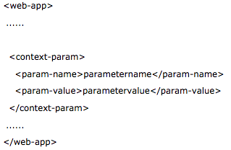
Using ServletContext
How to get the object of ServletContext interface:
getServletContext() method of ServletConfig interface returns the object of ServletContext.
getServletContext() method of GenericServlet class returns the object of ServletContext.
Syntax to provide the initialization parameter in Context scope

Slide 11
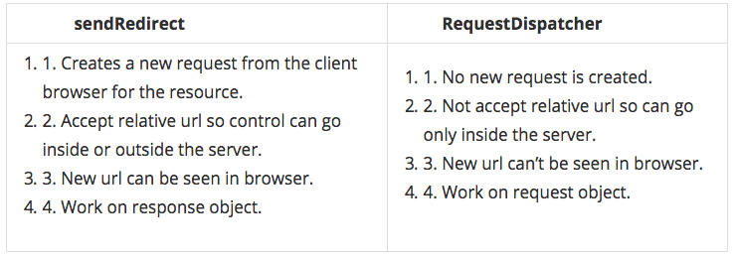
Servlet-Browser communication
setHeader(String name, String value): Sets a response header with the given name and value.
sendError(int sc): Sends an error response to the client using the specified status code and clearing the buffer.
sendRedirect() is the method of HttpServletResponse interface which is used to redirect response to another resource.

Slide 12
RequestDispatcher
The RequestDispatcher interface provides the facility of dispatching the request to another resource it may be html, servlet or jsp. This interface can also be used to include the content of another resource also. It is one of the way of servlet collaboration.
There are two methods defined in the RequestDispatcher interface.
1. public void forward(ServletRequest request,ServletResponse response)throws ServletException,java.io.IOException:Forwards a request from a servlet to another resource (servlet, JSP file, or HTML file) on the server.
2. public void include(ServletRequest request,ServletResponse response)throws ServletException,java.io.IOException:Includes the content of a resource (servlet, JSP page, or HTML file) in the response.

Slide 13
RequestDispatcher

Slide 14
Session Tracking in Servlets
HTTP is a "stateless" protocol which means each time a client retrieves a Web page, the client opens a separate connection to the Web server and the server automatically does not keep any record of previous client request.
Each time user requests to the server, server treats the request as the new request. So we need to maintain the state of an user to recognize to particular user.
Session Tracking is a way to maintain state (data) of an user. It is also known as session management in servlet.
Why use Session Tracking?
To recognize the user It is used to recognize the particular user.
Session Tracking Techniques
There are four techniques used in Session tracking:
1. Cookies: A webserver can assign a unique session ID as a cookie to each web client and for subsequent requests from the client they can be recognized using the recieved cookie. Not a recommended way.
2. Hidden Form Field: A web server can send a hidden HTML form field along with a unique session ID
3. URL Rewriting: You can append some extra data on the end of each URL that identifies the session, and the server can associate that session identifier with data it has stored about that session.
4. HttpSession: Apart from the above mentioned three ways, servlet provides HttpSession Interface which provides a way to identify a user across more than one page request or visit to a Web site and to store information about that user.

Slide 15
What are we learning in Next Chapter ?
You will learn about Advanced JDBC
We will learn about:
RowSet
CachedRowSet
Connection Pooling (using javax.sql.DataSource interface)
Transactions , Commits, Rollbacks
Transaction Isolation Levels
BLOB
CLOB

Slide 16
Thank You !

